Slide 1
Raiffeisen AI Course
Introduction to AI

Slide 2
Decoding the Black Box
Introduction on
How Machine Learning Models Make Decisions

Slide 3
Content
Gradient descent
Tree based algorithms
Neural Networks
Sentiment analysis model
Text autocomplete model

Slide 4
Gradient descent - black-box tool
The most popular learning method in Machine Learning
Used in many algorithms from classical ML algorithms to deep neural networks
Many people use it but do not understand it
Gradient descent - a way to minimize an objective function

Slide 5
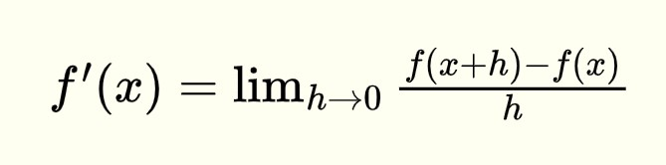
Derivata de gradul I
Derivata unei funcții f(x) reprezintă rata de variație a funcției în raport cu variabila sa.
Derivata poziției → viteza
Derivata vitezei → accelerația
Derivata funcției salariului în funcție de timp → rata de creștere a salariului

Slide 6
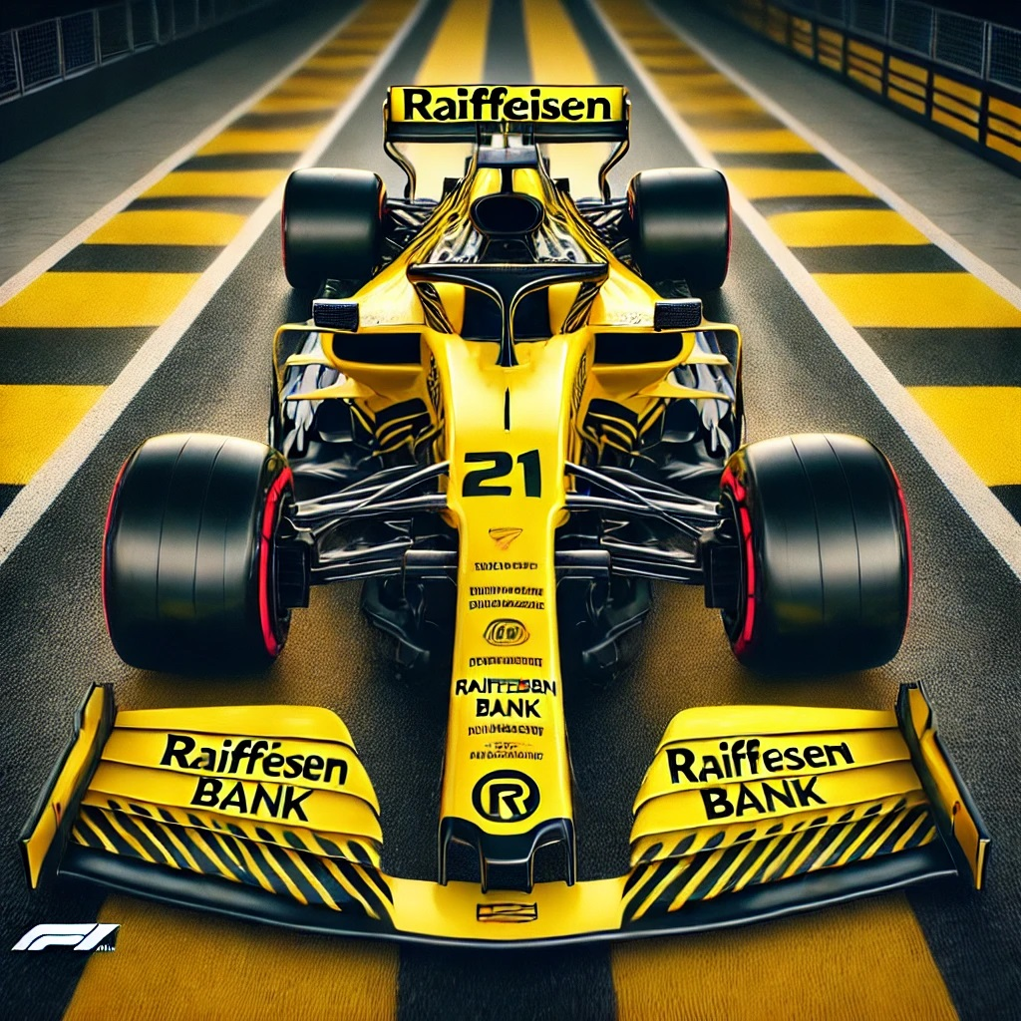
Speed - Acceleration
T - Time (measured in seconds)
V - speed (km/h * 10)
Interval 0 - 3s:
1.5s - acceleration
1.5s - break
V(T) = 4T(3 - T)

Slide 7
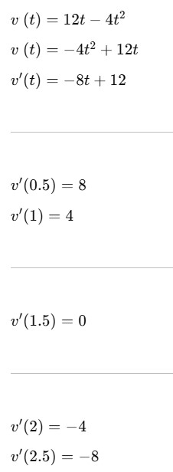
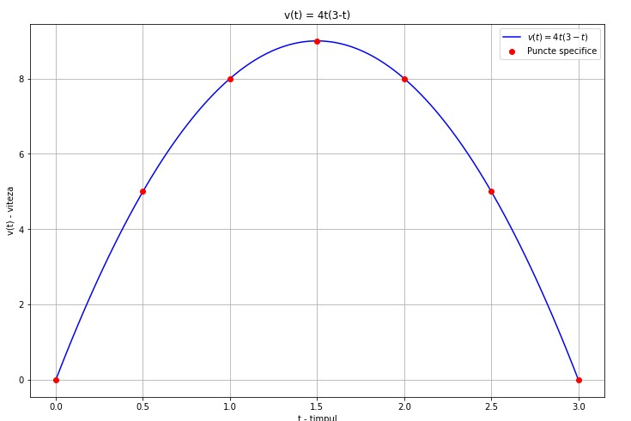
Exemplu: v(t) = 4t(3 - t)

Slide 8
Gradient descent weights
Gradient descent models use weights
X - feature
Y - target
A - weight
X * a = Y
A - “magic variable”
X
Y

Slide 9
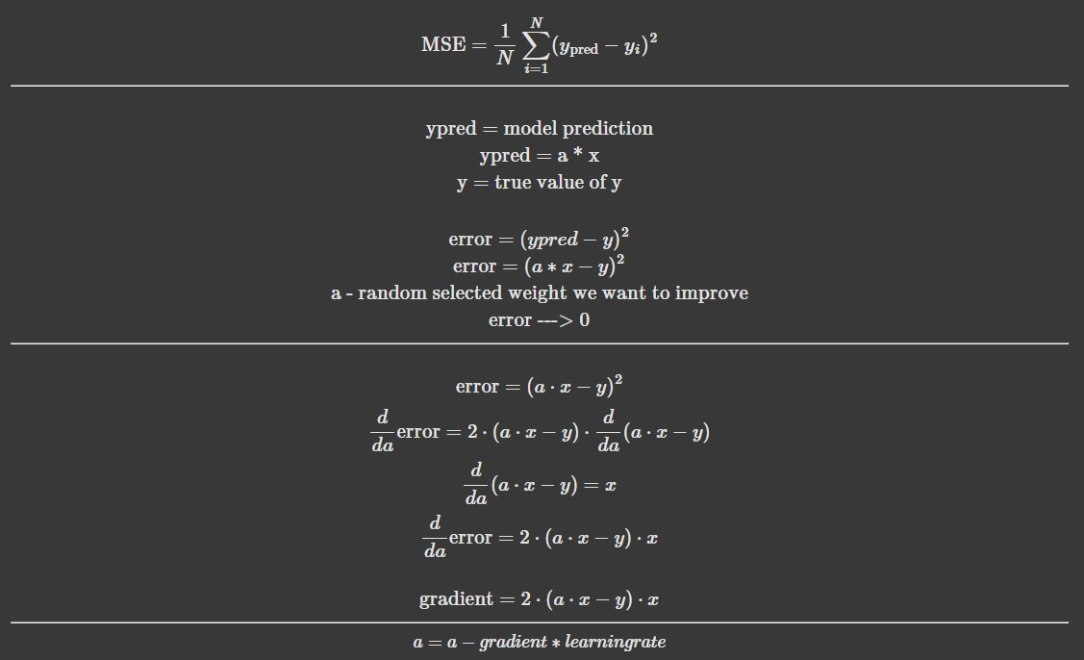
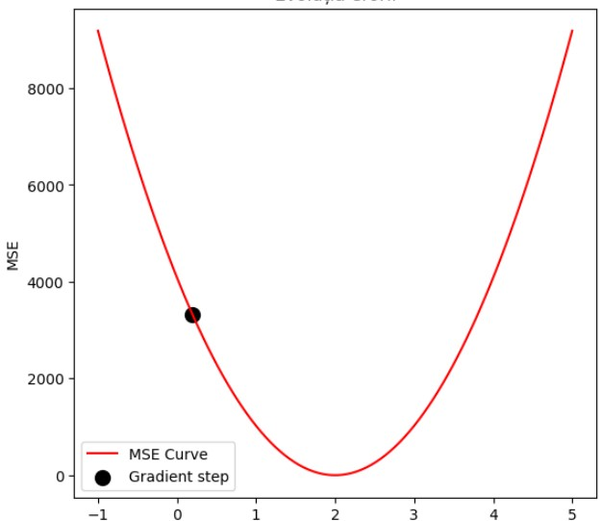
Learning step
(Ypred - Y)**2

Slide 10
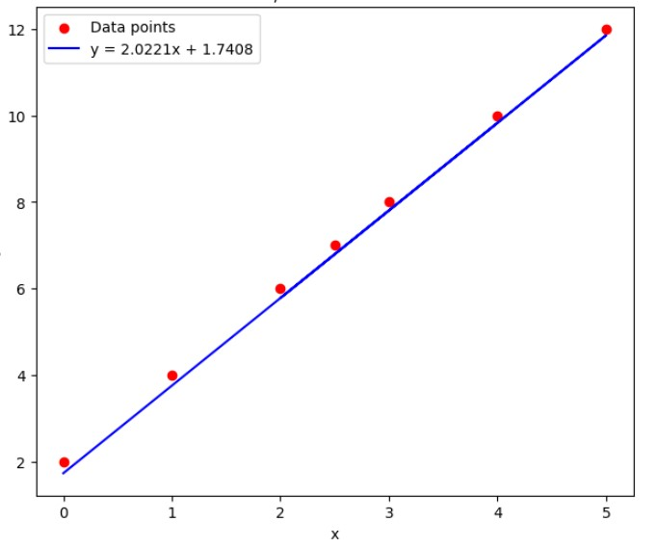
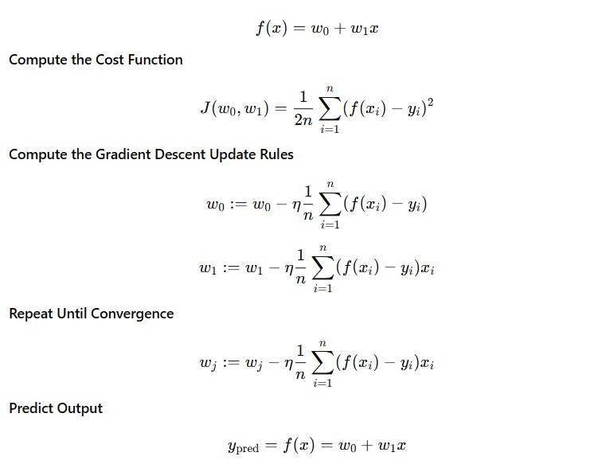
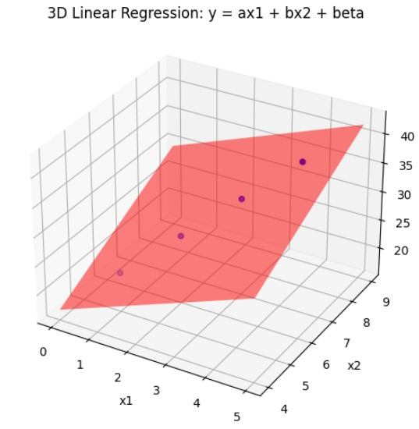
Linear regression

Slide 11
Q1. Gradient descent variants
Which method is better?
SGD - one point per step
Batch GD - all points per step
Variant | Description | Time | Memory
Stochastic GD | One point | ? | ?
Batch GD | All points | ? | ?

Slide 12
Gradient descent variants
Variant | Description | Time | Memory
Stochastic GD | One point | Slow | Low
Batch GD | All points | Fast | High

Slide 13
Gradient descent variants
Variant | Description | Time | Memory
Stochastic GD | One point | Slow | Low
Batch GD | All points | Fast | High
Variant | Description | Time | Memory
Stochastic GD | One point | Slow | Low
Batch GD | All points | Fast | High
Mini-Batch GD | Batches | Medium | Medium

Slide 14
Q2. Starting point
If we start the gradient from 2 random points both will go in the same point?

Slide 15
Q2. Starting point
If we start the gradient from 2 random points both will go in the same point?

Slide 16
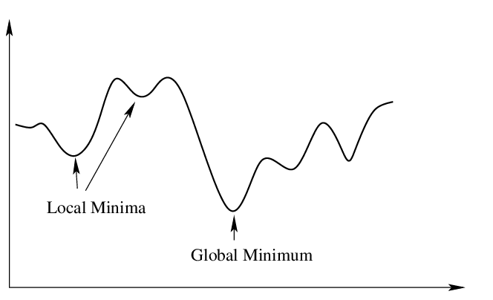
Q2. Starting point
If we start the gradient from 2 random points both will go in the same point?

Slide 17
Q3. Will GD conduct to ZERO error?

Slide 18
Q4. We always need global minimum?

Slide 19
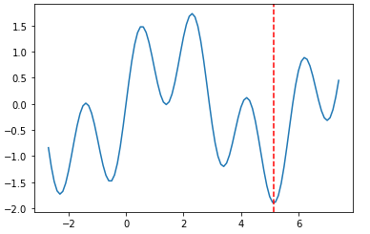
Q4. We always need global minimum?

Slide 20
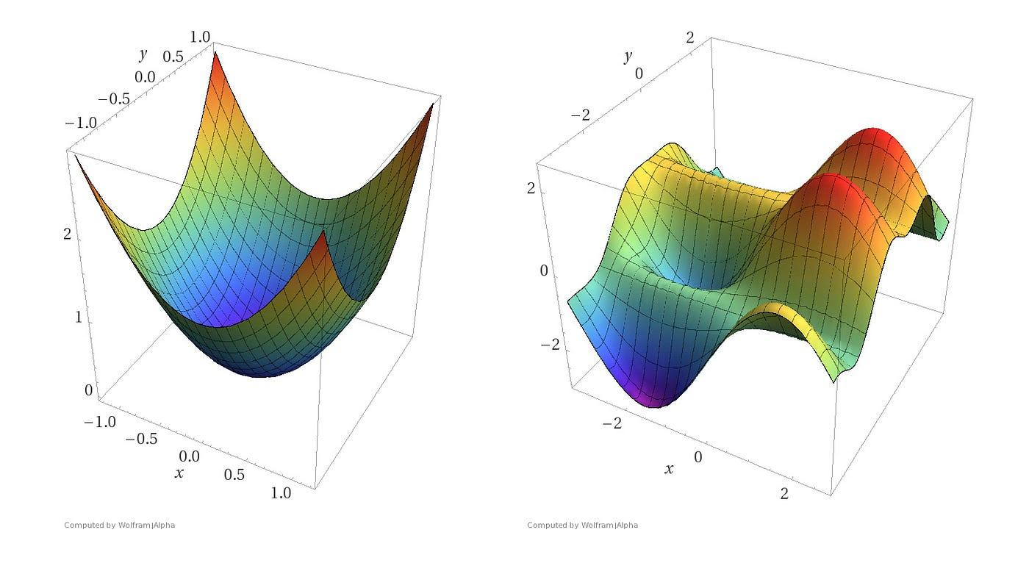
Local and global minim

Slide 21

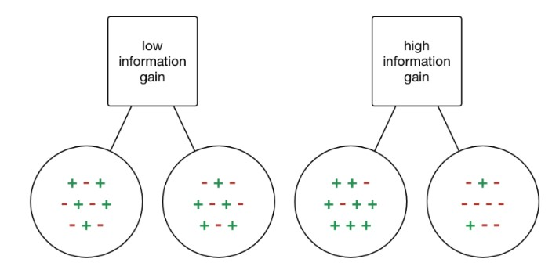
Decision Tree
Yesterday
Entropy is a measure of the randomness in the information being processed
No
Yes
Weather
NO
Yesterday | Weather | Time | Decision
No | Sunny | Weekend | YES
No | Sunny | Workday | YES
Yes | Rainy | Weekend | NO
No | Rainy | Workday | NO
Yes | Sunny | Workday | NO
Yes | Sunny | Weekend | NO
No | Rainy | Weekend | YES
Rainy
Sunny
Time
YES
Weekend
Workday
YES
NO

Slide 22
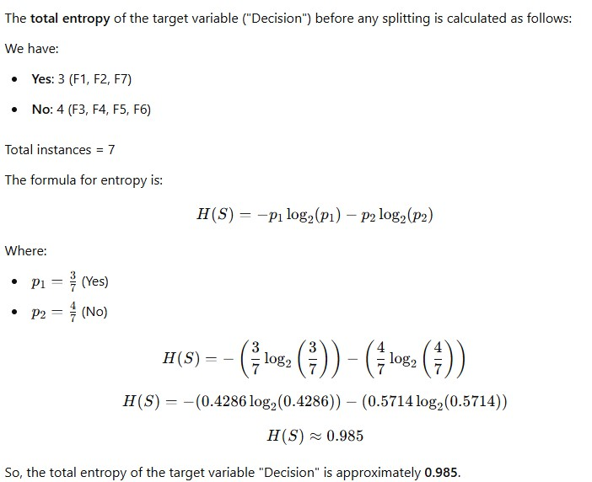
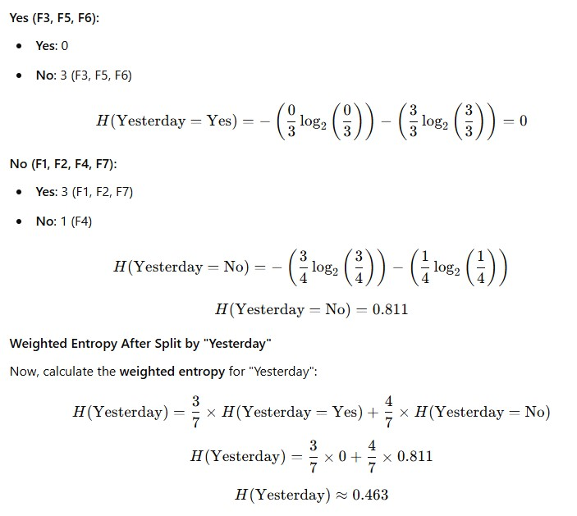

Slide 23
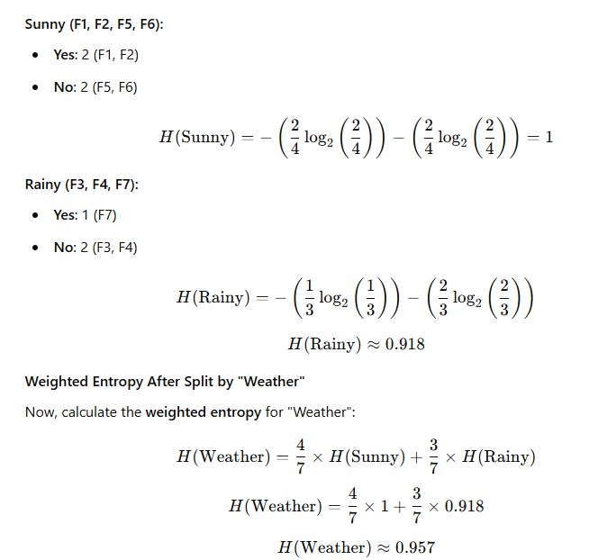
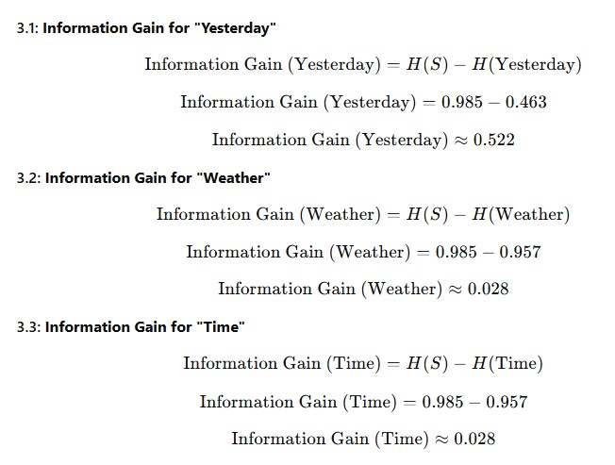

Slide 24
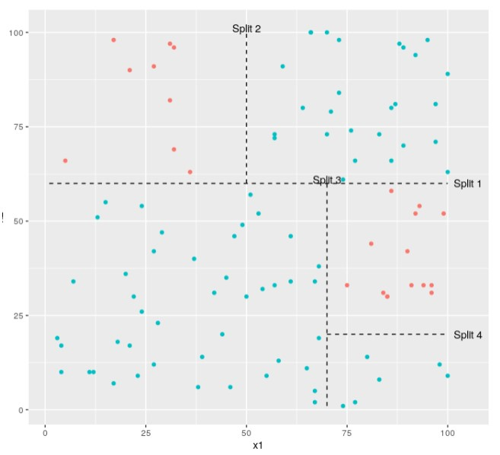
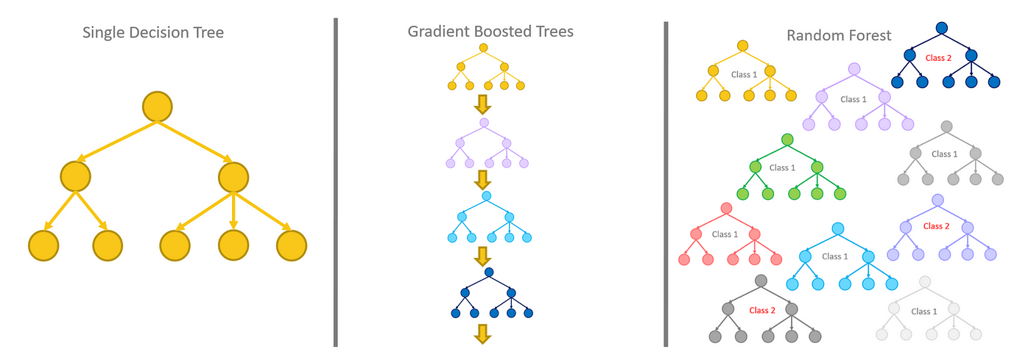
Bagging and boosting
Underfitting
Overfitting
Model complexity
Bagging - reduces complexity (reduce overfitting)
Boosting - increase complexity (reduce underfitting)

Slide 25
Q1
Which model is more complex and learn more:
One decision tree with all features and samples
Two decision trees with features and samples splitted

Slide 26
Q2
Can we use string features for categorical variables is a decision tree?

Slide 27
Q3
How high correlated features may affect a decision tree?

Slide 28
Q4
How a decision tree works with outliers

Slide 29
Text features
Models works only with numeric features
How we transform text features in numeric features
Label Encoding
One Hot Encoder
TF-IDF vectorizer

Slide 30
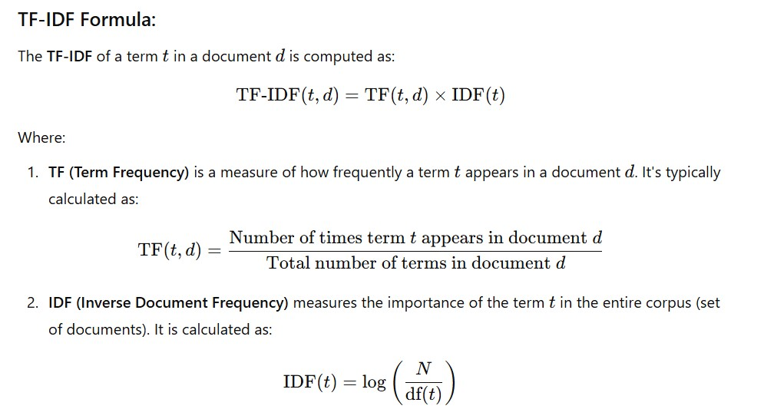

Slide 31
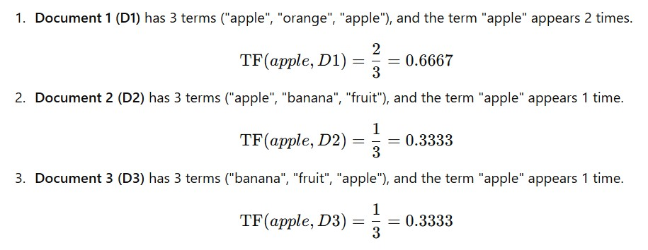
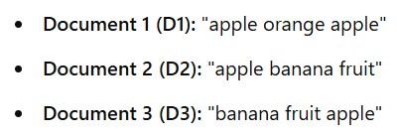
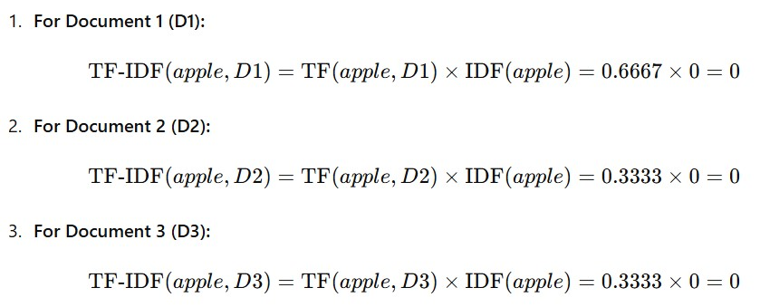


Slide 32
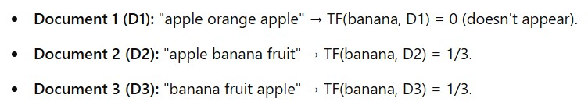
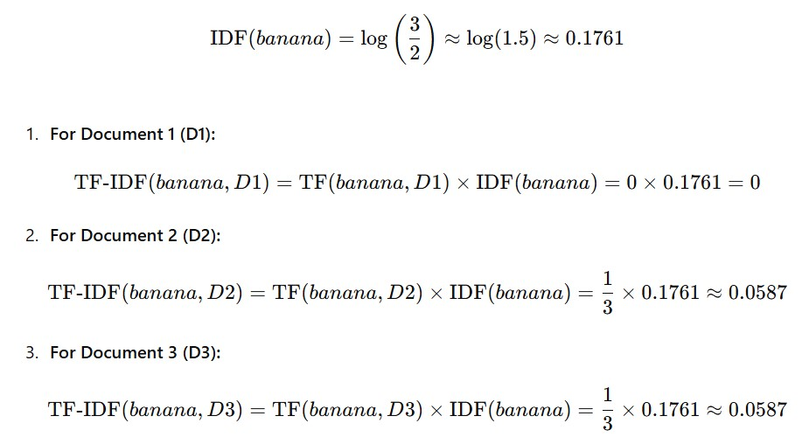

Slide 33
Output example
 | w1 | w2 | w3 | w4 | w5 | w6
D1 | 0 | 0.157 | 0.053 | 0 | 0.021 | 0.251
D2 | 0.027 | 0 | 0 | 0.058 | 0.027 | 0
D3 | 0 | 0.058 | 0.053 | 0 | 0.027 | 0.072
D4 | 0.002 | 0 | 0.157 | 0.027 | 0 | 0.157

Slide 34
Questions
Q1. How is TF-IDF in terms of natural language understanding?
Q2. How is TF-IDF in terms of memory?

Slide 35
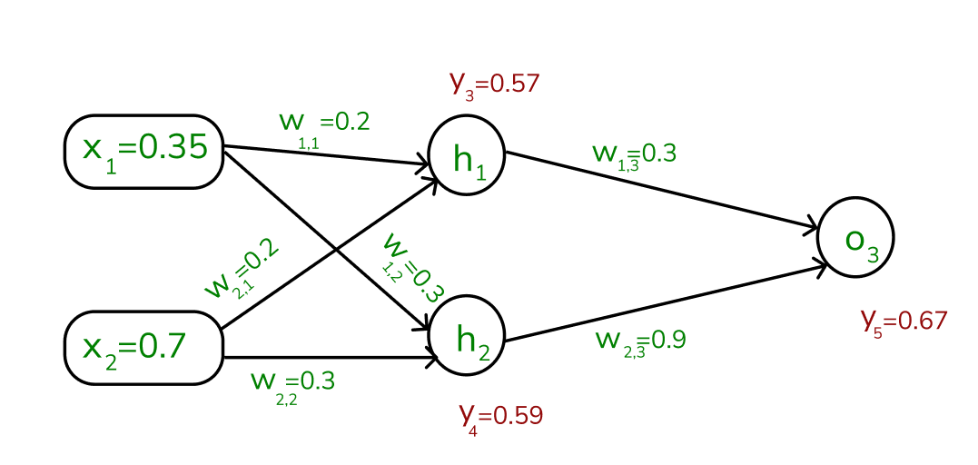
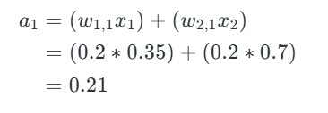
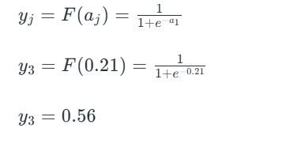
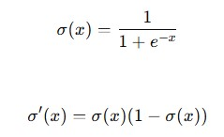

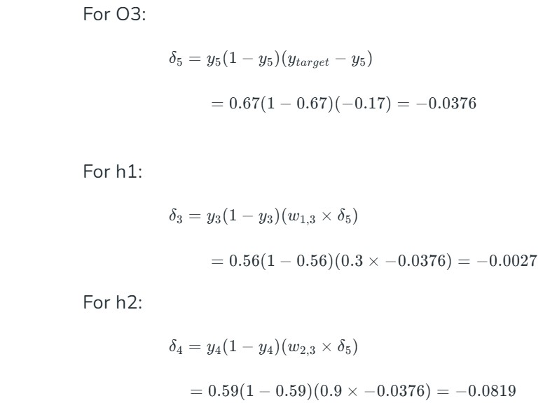
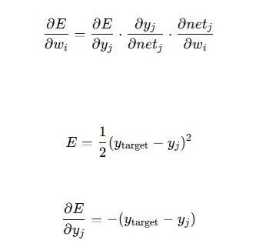
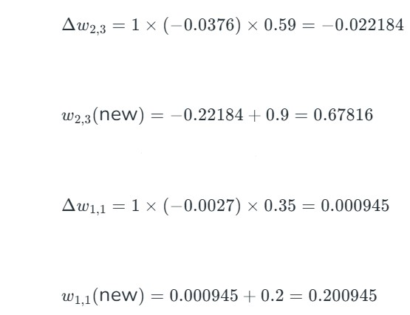
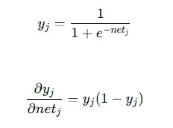
Neural Networks

Slide 36
Questions
What is the role of activation functions in hidden layers?

Slide 37
Word embeddings
A word embedding is a learned representation of a word such that the words with same meaning have similar representation.
The geometric relationship between words should reflect the semantic relationship.
The vocabulary is predefined and learned over a large corpus of text.
KING - MAN + WOMAN = QUEEN

Slide 38
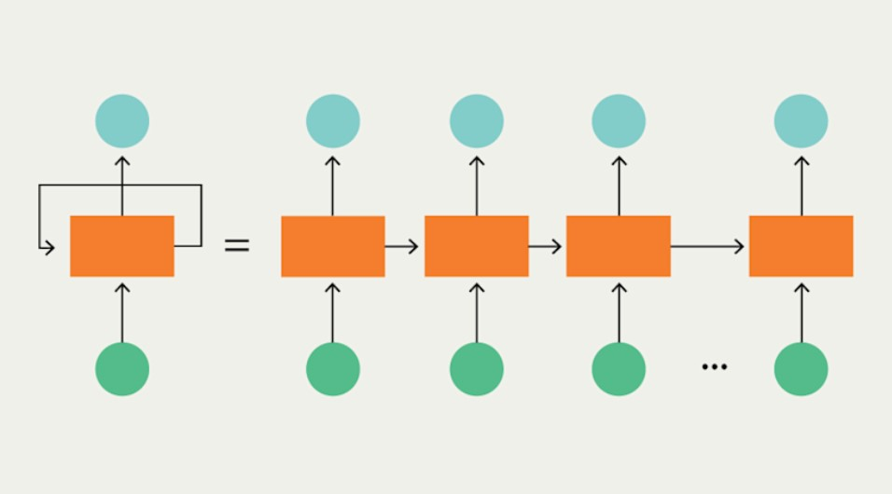
Recurrent neural networks
[dog, cat, fox]
[[0.1, 0.2, 0.3, 0.4],
[0.5, 0.6, 0.7, 0.8],
[0.9, 0.1, 0,5, 0.7]]

Slide 39
Demo
Text autocomplete
Word2Vec
RNN - LSTM
Evaluation

Slide 40
Transformers
Like the RNNs, transformers can handle distant information
RNNs struggle with long sequence data.
Transformers are not based on recurrent connections
Transformers are more efficient to implement at scale
Transformers are made up of stacks of transformer blocks, each of which is a multilayer network made by combining:
● simple linear layers
● feedforward networks
● self-attention layers
Self-attention allows a network to directly extract and use information from arbitrarily large contexts without the need to pass it through intermediate recurrent connections as in RNNs

Slide 41
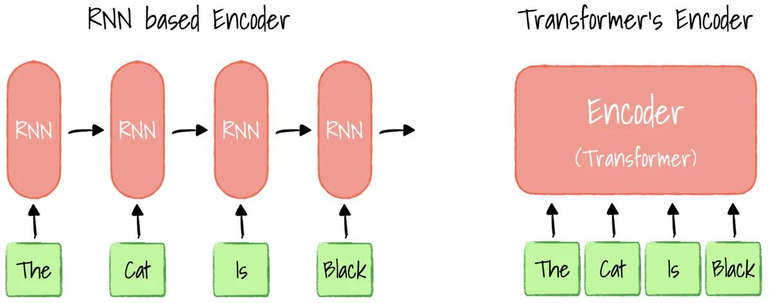
Transformers

